Slide 1
Chapter Thirteen
Retailing and Wholesaling

Slide 2
Retailing and Wholesaling
Topic Outline
Retailing
Retailer Marketing Decisions
The Future of Retailing
Wholesaling

Slide 3
Retailing
Retailing includes all the activities in selling products or services directly to final consumers for their personal, non-business use
Retailers are businesses whose sales come primarily from retailing

Slide 4
Retailing
Types of Retailers
Amount of service
Self-service
Limited service
Full service

Slide 5
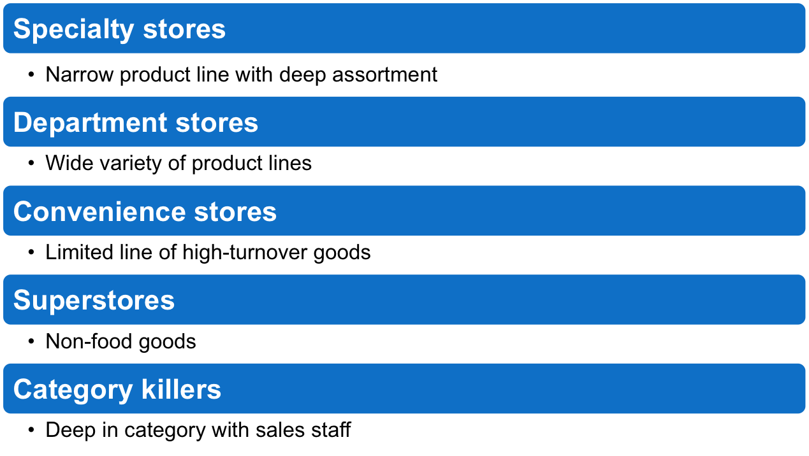
Retailing
Product Line

Slide 6
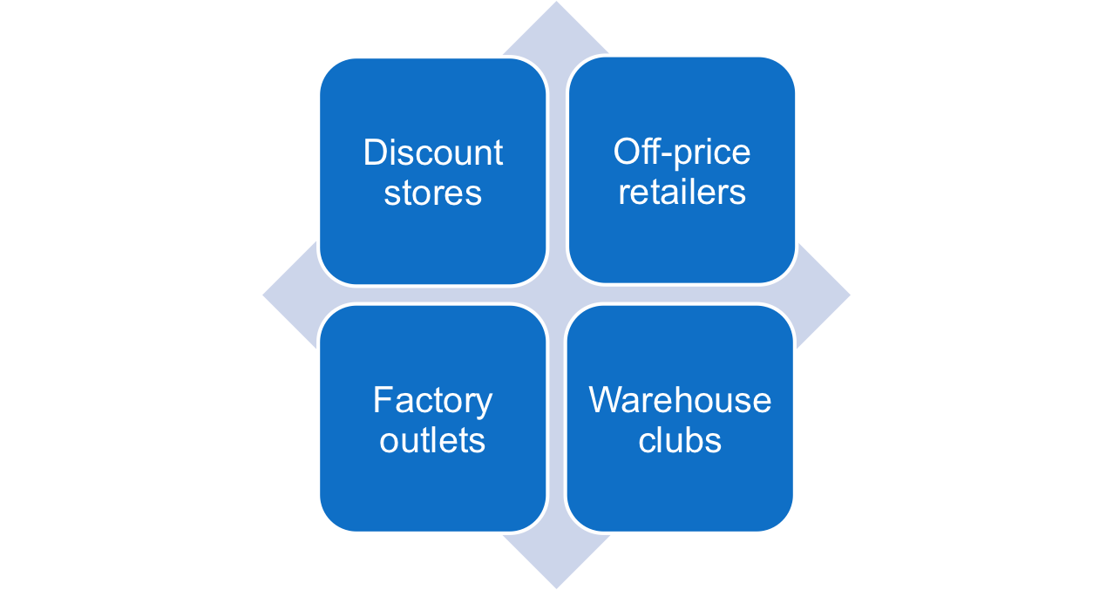
Retailing
Types of Retailers
Relative Prices

Slide 7
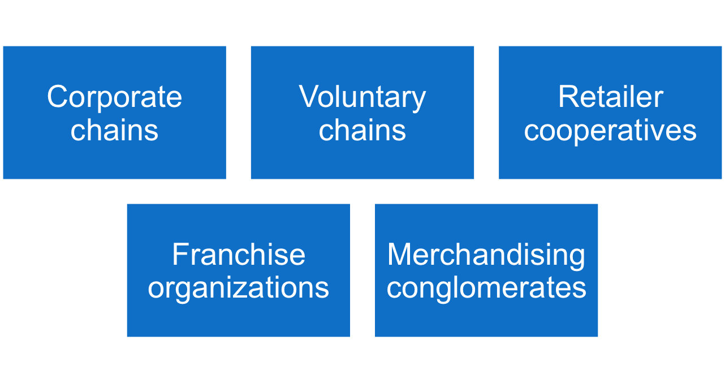
Retailing
Types of Retailers
Organizational Approach

Slide 8
Retailing
Types of Retailers
Organizational Approach
Corporate chains are two or more outlets that are commonly owned and controlled
Size allows them to buy in large quantities at lower prices and gain promotional economies
  Sears
  CVS

Slide 9
Retailing
Types of Retailers
Organizational Approach
Voluntary chains are wholesale-sponsored groups of independent retailers that engage in group buying and common merchandising
IGA
Western Auto

Slide 10
Retailing
Types of Retailers
Organizational Approach
Retailer cooperatives is a group of independent retailers that band together to set up a joint-owned, central wholesale operation and conduct joint merchandising and promotion effort
Ace Hardware
Associated Grocers

Slide 11
Retailing
Types of Retailers
Organizational Approach
Franchise organizations are based on some unique product or service; on a method of doing business; or on the trade name, good will, or patent that the franchisor has developed
Holiday Inn

Slide 12
Retailing
Types of Retailers
Organizational Approach
Merchandising conglomerates are corporations that combine several retailing forms under central ownership
Limited Brands

Slide 13
Retailing
Retailer Marketing Decisions
Segmentation, targeting, differentiation, and positioning involves the definition and profile of the market so the other retail marketing decisions can be made

Slide 14
Retailing
Retailer Marketing Decisions
Product Assortment and Service
Product assortment and service decisions include:
Product assortment
Services mix
Store atmosphere

Slide 15
Retailing
Retailer Marketing Decisions
Price Decision
Price policy must fit the target market and positioning, product and service assortment, and competition
High markup on lower volume
Low markup on higher volume

Slide 16
Retailing
Retailer Marketing Decisions
Price Decision
High-low pricing involves charging higher prices on an everyday basis, coupled with frequent sales and other price promotions
Everyday low price (EDLP) involves charging constant, everyday low prices with few sales or discounts

Slide 17
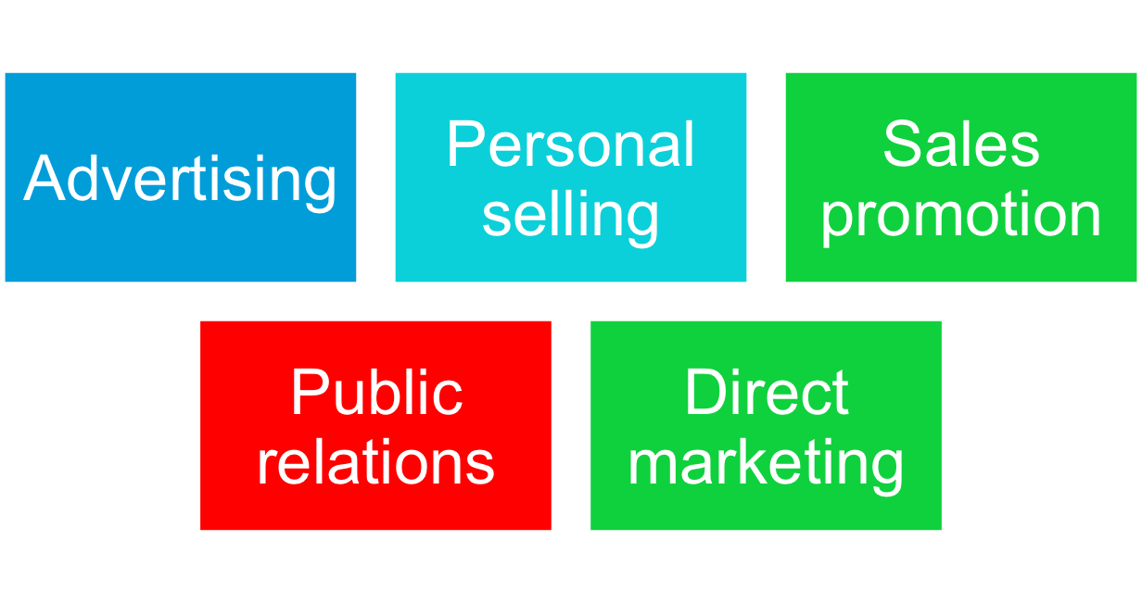
Retailing
Retailer Marketing Decisions
Promotion Decision

Slide 18
Retailing
Retailer Marketing Decisions
Place Decision
Central business districts are located in cities and include department and specialty stores, banks, and movie theaters
Shopping center is a group of retail businesses planned, developed, owned, and managed as a unit
Regional shopping centers
Community shopping centers
Neighborhood shopping centers
Power center
Lifestyle centers

Slide 19
Retailing
The Future of Retailing
Retailers have to choose target segments carefully, position themselves strongly, and consider the following developments as they plan and execute their competitive strategies
Non-store retailing
Retail convergence
Megaretailers
Retail technology
Global expansion
Retail stores as communities

Slide 20
Retailing
The Future of Retailing
New Retail Forms and Shortening Retail Life Cycles
Wheel-of-retailing concept states that many new types of retailing forms begin as low-margin, low-price, low-status operations, and challenge established retailers. As they succeed they upgrade their facilities and offer more services, increasing their costs and forcing them to increase prices, eventually becoming the retailers they replaced.

Slide 21
Retailing
The Future of Retailing
New Retail Forms and Shortening Retail Life Cycles
Growth of non-store retailing includes:
Mail order
Television
Phone
Online

Slide 22
Retailing
The Future of Retailing
New Retail Forms and Shortening Retail Life Cycles
Retail convergence involves the merging of consumers, producers, prices, and retailers, creating greater competition for retailers and greater difficulty differentiating offerings

Slide 23
Retailing
The Future of Retailing
New Retail Forms and Shortening Retail Life Cycles
The rise of megaretailers involves the rise of mass merchandisers and specialty superstores, the formation of vertical marketing systems, and a rash of retail mergers and acquisitions
Superior information systems
Buying power
Large selection

Slide 24
Retailing
The Future of Retailing
New Retail Forms and Shortening Retail Life Cycles
Growing importance of retail technology provides better forecasts, inventory control, electronic ordering, transfer of information, scanning, online transaction processing, improved merchandise handling systems, and the ability to connect with customers

Slide 25
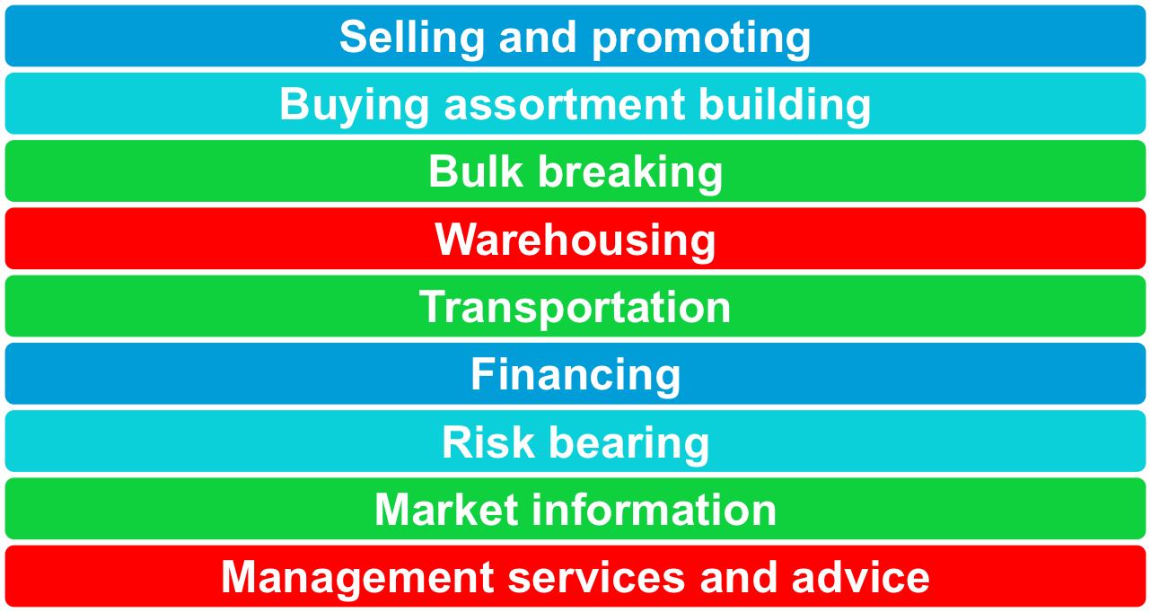
Wholesaling
Wholesaling includes all activities involved in selling goods and services to those buying for resale or business use

Slide 26
Wholesaling
Wholesaling
Selling and promoting involves the wholesaler’s sales force helping the manufacturer reach many smaller customers at lower cost
Buying assortment building involves the selection of items and building of assortments needed by their customers, saving the customers work

Slide 27
Wholesaling
Wholesaling
Bulk breaking involves the wholesaler buying in larger quantity and breaking into smaller lots for its customers
Warehousing involves the wholesaler holding inventory, reducing its customers’ inventory cost and risk

Slide 28
Wholesaling
Wholesaling
Transportation involves the wholesaler providing quick delivery due to its proximity to the buyer
Financing involves the wholesaler providing credit and financing suppliers by ordering earlier and paying on time

Slide 29
Wholesaling
Wholesaling
Risk bearing involves the wholesaler absorbing risk by taking title and bearing the cost of theft, damage, spoilage, and obsolescence
Market information involves the wholesaler providing information to suppliers and customers about competitors, new products, and price developments

Slide 30
Wholesaling
Wholesaling
Management services and advice involves wholesalers helping retailers train their sales clerks, improve store layouts, and set up accounting and inventory control systems

Slide 31
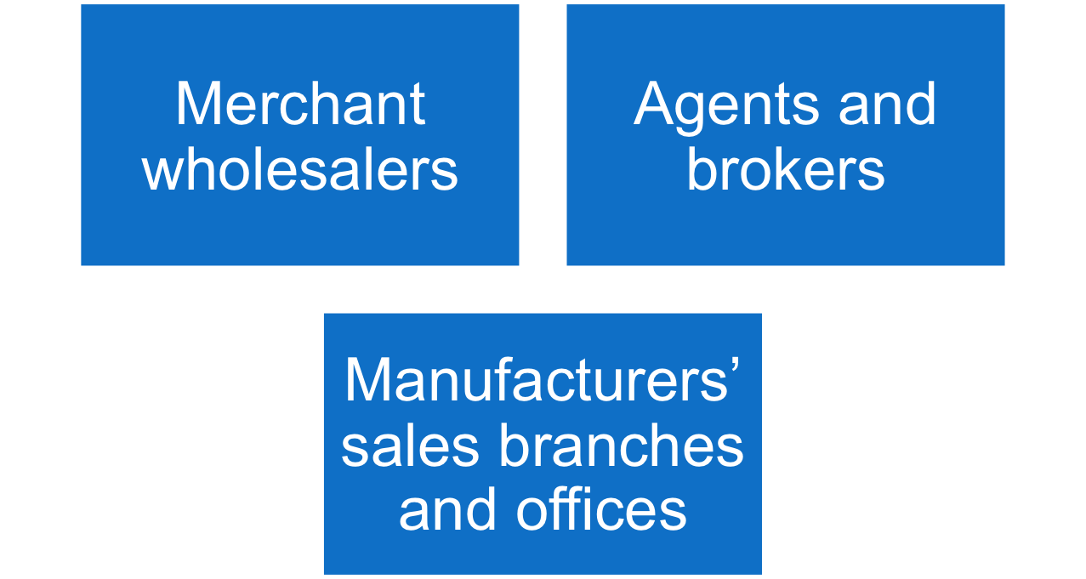
Wholesaling
Types of Wholesalers

Slide 32
Wholesaling
Types of Wholesalers
Merchant wholesalers is the largest group of wholesalers and include:
Full-service wholesalers who provide a full set of services
Limited service wholesalers who provide few services and specialized functions

Slide 33
Wholesaling
Types of Wholesalers
Brokers and agents do not take title, perform a few functions, and specialize by product line or customer type
Brokers bring buyers and sellers together and assist in negotiations
Agents represent buyers or sellers

Slide 34
Wholesaling
Types of Wholesalers
Manufacturers’ sales branches and offices is a form of wholesaling by sellers or buyers themselves rather than through independent wholesalers

Slide 35
Wholesaling
Wholesaler Marketing Decisions
Target market and positioning decisions
Size of customer
Type of customer
Need for service

Slide 36
Wholesaling
Wholesaler Marketing Decisions
Marketing mix decisions
Product
Price
Promotion
Place

Slide 37
Wholesaling
Trends in Wholesaling
Challenges
Resistance to price increases
Lack of suppliers
Changing customer needs
Adding value by increasing efficiency and effectiveness

